Slide 1
Workshop 3B
Keeping Records

Slide 2



Why Keep Records?
Because you won’t remember everything!
Because you need to share work!
Legislative Requirements!

Slide 3
What type of records are we talking about?
Experimental note taking / logbooking.
Collaborative / Project Documentation
Special: Human Research

Slide 4
Experiment Logs (Logbook)

Slide 5
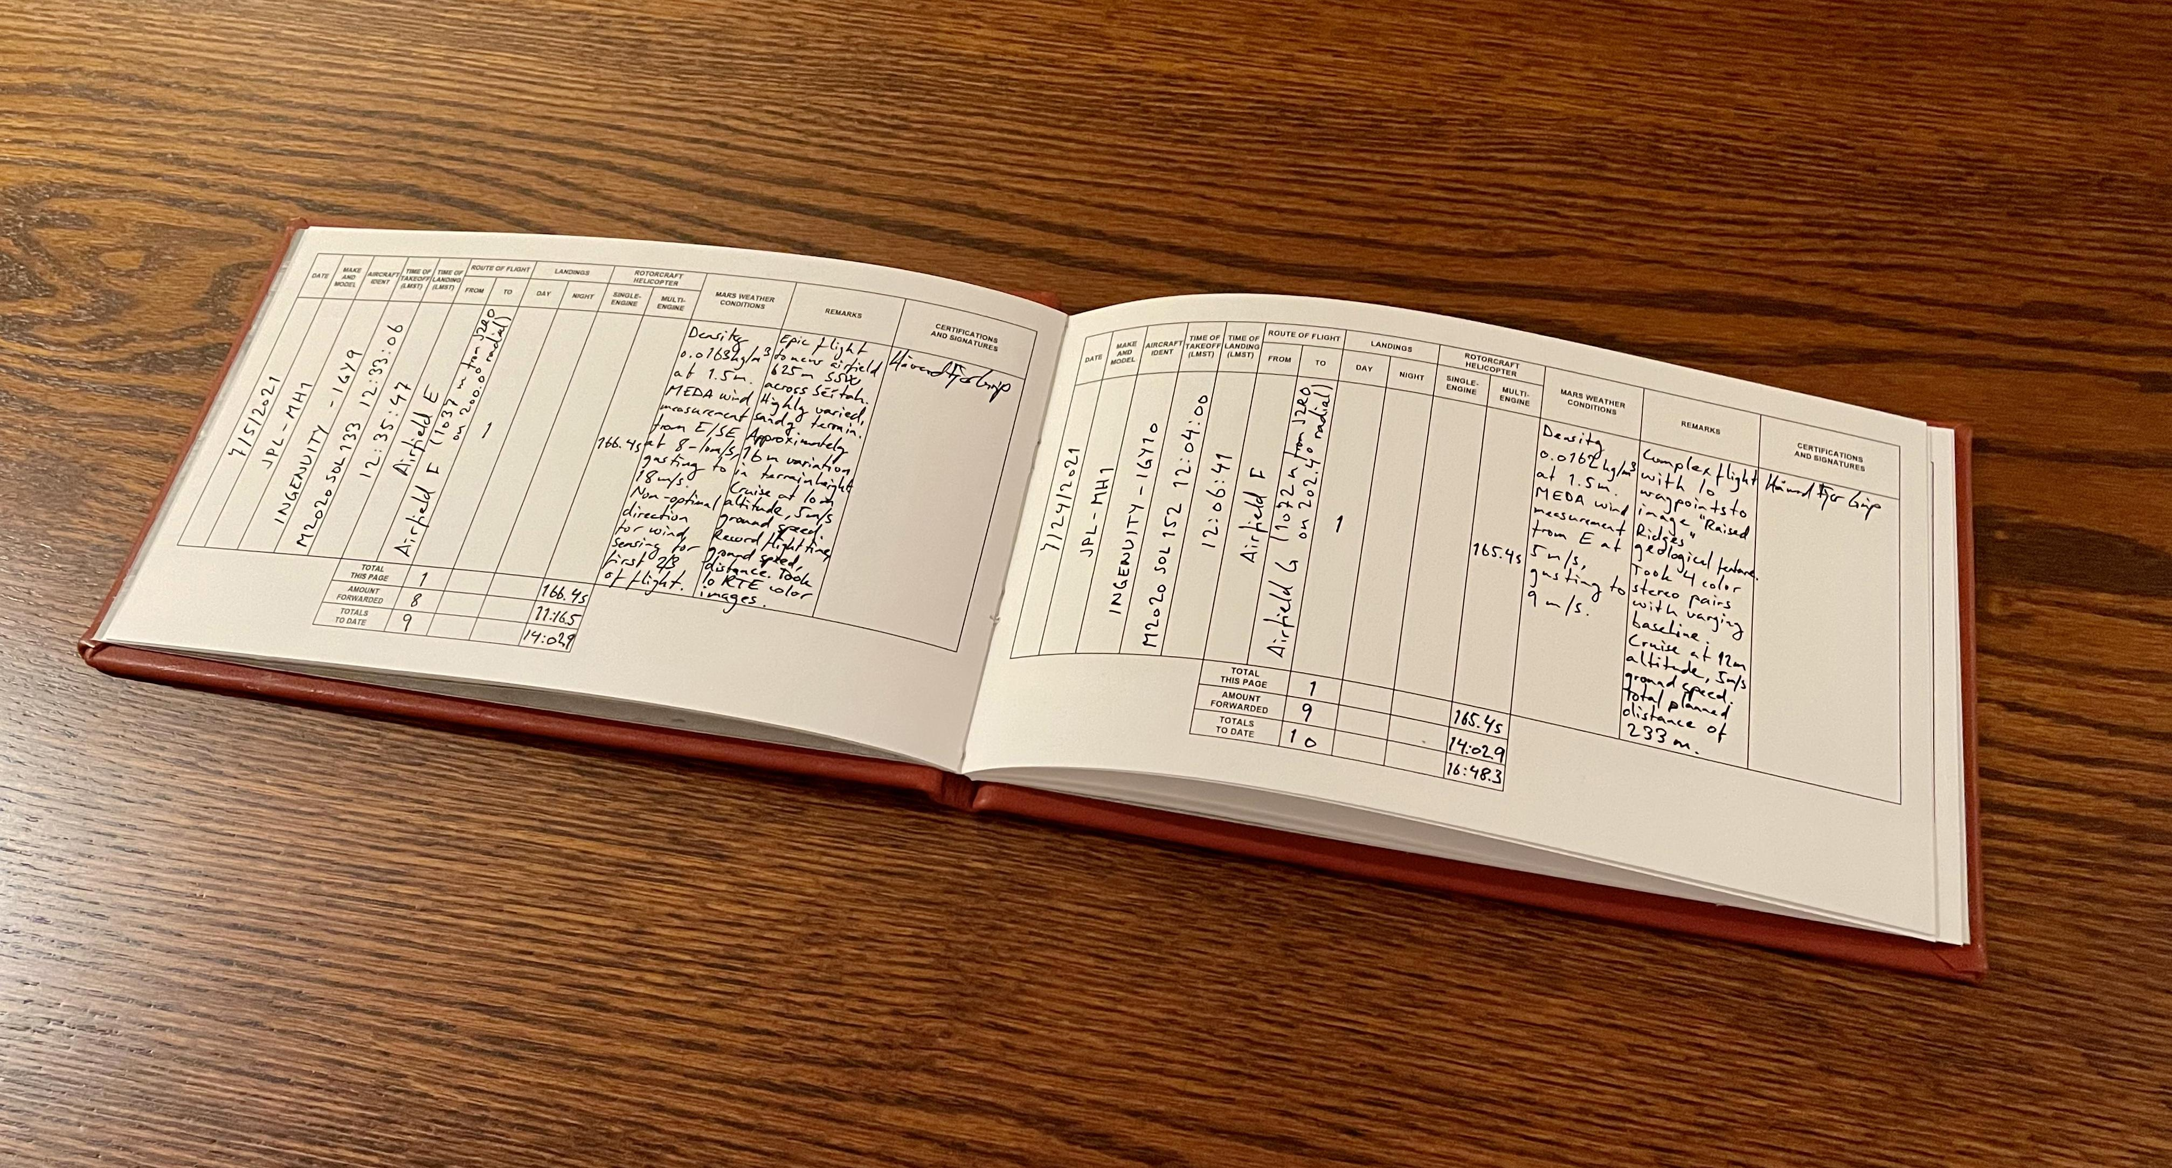
What is a logbook?
Your Record of Everything!
Has all the details from your experiment in it.

Slide 6
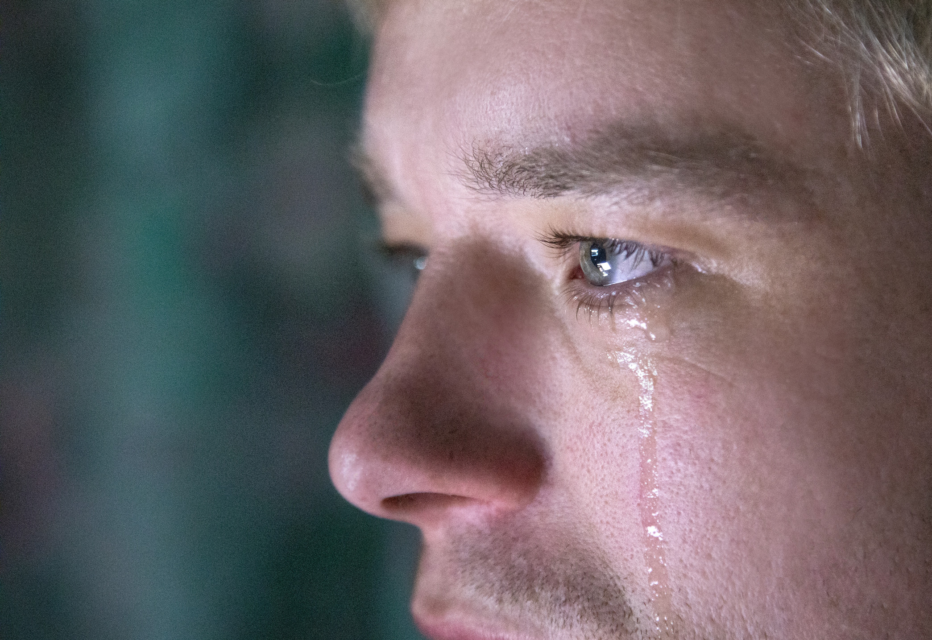
Why should you care?
The number one rule of logbooking is that it should contain enough information for you to repeat your experiment far in the future and know if the results are the same.
When you didn’t make good logs and need to revisit an experiment from years ago

Slide 7

Good Records: how?
Date, Time, Location / Environment: Really useful when you’re tracking across many days / years.
Experiment Plan / Goal: Usually written before you begin your experiments, one or two lines. Useful to keep yourself on-task after long runs of data gathering.
Table(s) of Data: Your actual data that you have gathered! Make it neat and legible as this is the most important part of your logbook.

Slide 8
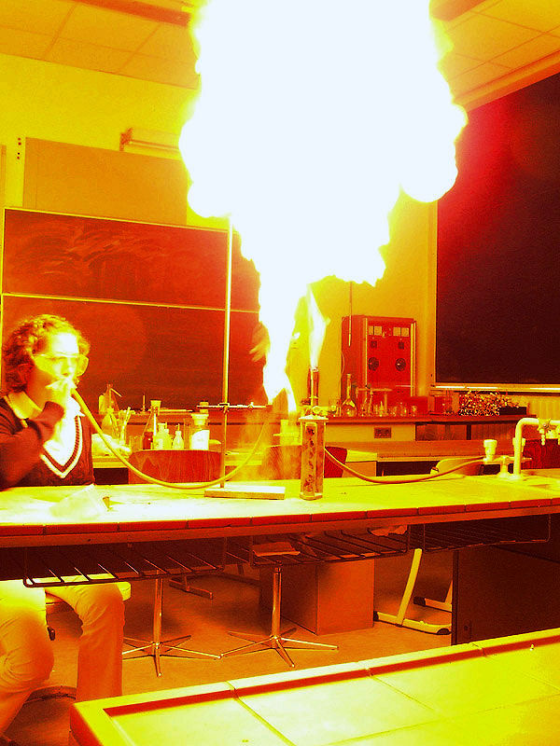
Good Records: how?
Interpretations of Data: Your preliminary thoughts on the data; what’s interesting, what needs to be repeated, what data is ‘good’ and what data are ‘bad’?
Any Events of Note: If anything interesting happens during the experiment that you think is notable (maybe a capacitor blew up?), record it down!
Preliminary Conclusions / Goals for the next day: After the lab session, reflect on what you’ve gotten done, and whether you achieved your goal. Set a goal for the next experiment session if you can; if not, that’s where you talk to your supervisor!

Slide 9

Good Records: how?
Efficiency: Don’t repeat methods that have been recorded elsewhere. Just write “set up according to method seen in “X””. You want to spend most of your time on the interesting stuff; data and preliminary interpretations.
Legibility: Your logbook needs to be readable by the you four years from now; try to avoid shorthand unless you’re definitely sure it is going to remain in your vocabulary.
It’s your logbook!: Put any extraneous stuff you want in! Pictures, thoughts, a poem; make sure you treat your logbook as part of your own experimental practice.

Slide 10
EXAMPLES!

Slide 11
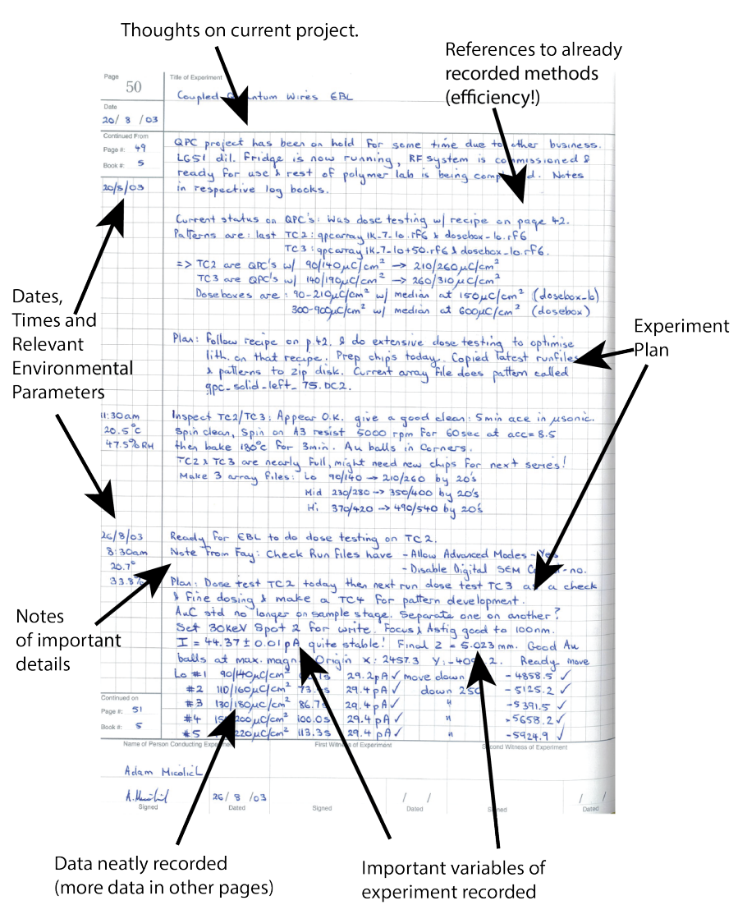
A good Example

Slide 12
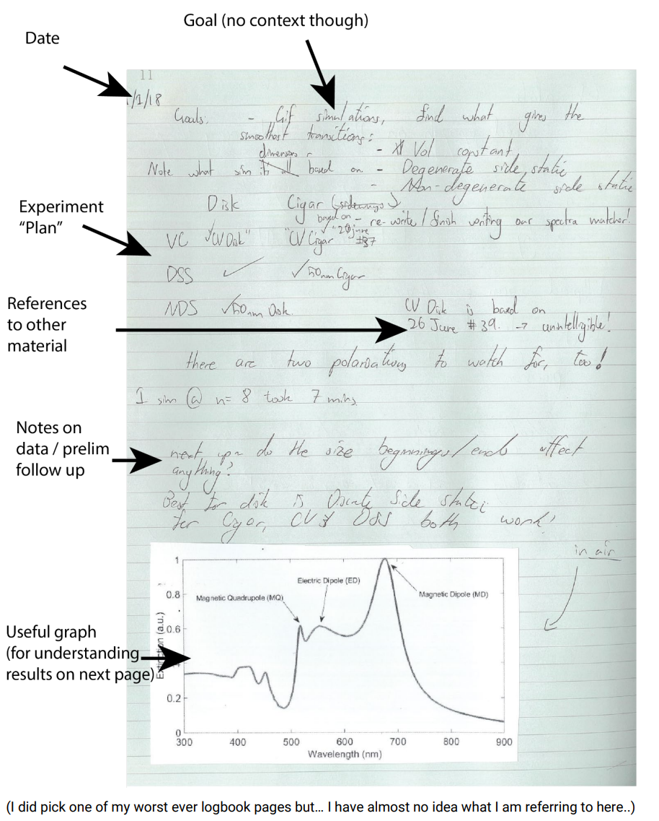
A Mid Example

Slide 13
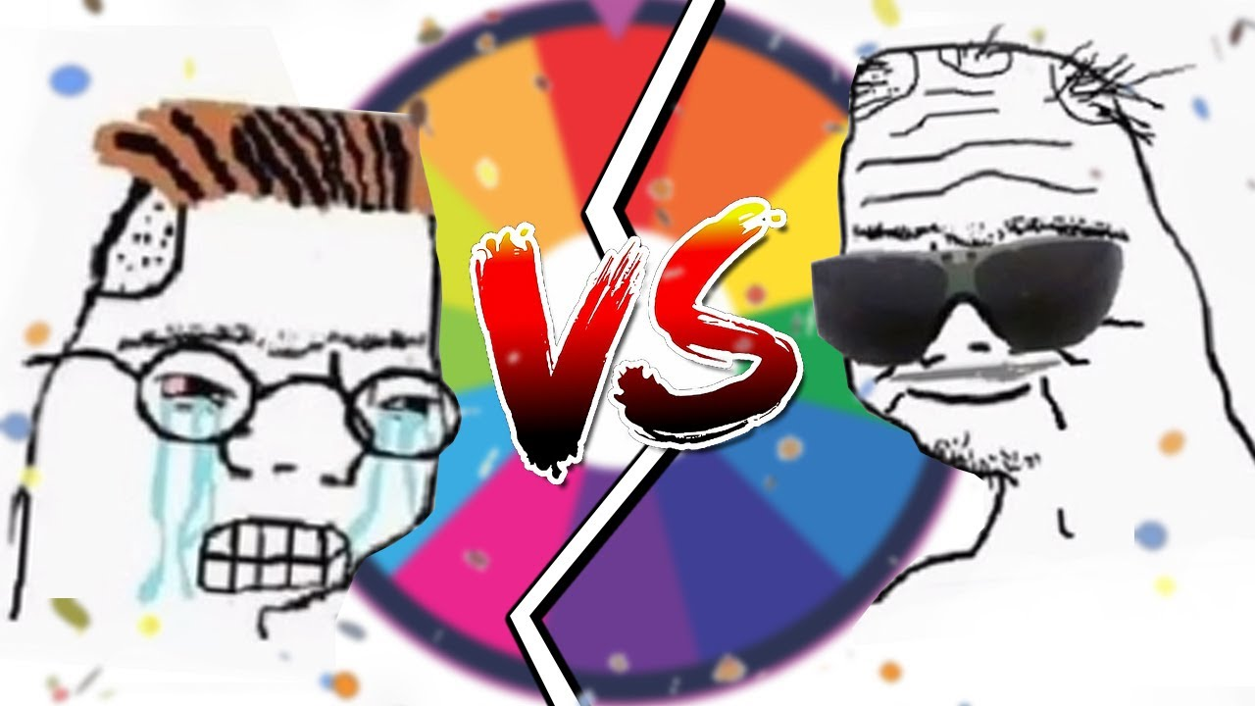
Digital or Physical?
Either! As long as:
It should be easy to keep everything together; no loose pages or loose files!
You shouldn’t need to do a lot of setup each day to begin recording data.
You need to be able to bring it to where you conduct your experiments.

Slide 14
Activity 1 – Improve These Notes
I’ll share some notes – record what’s good and what’s bad about them!
Can you understand them?

Slide 15
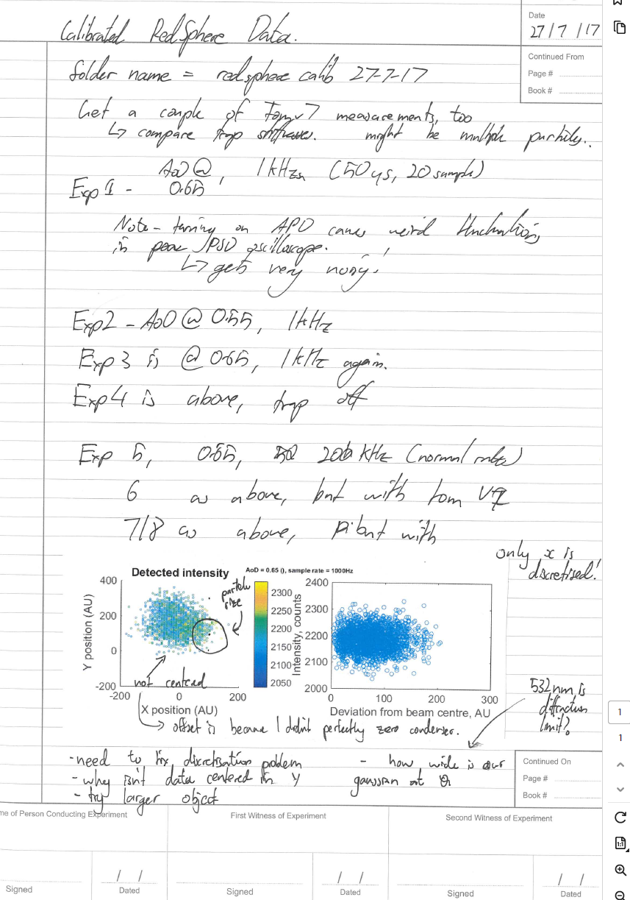

Slide 16
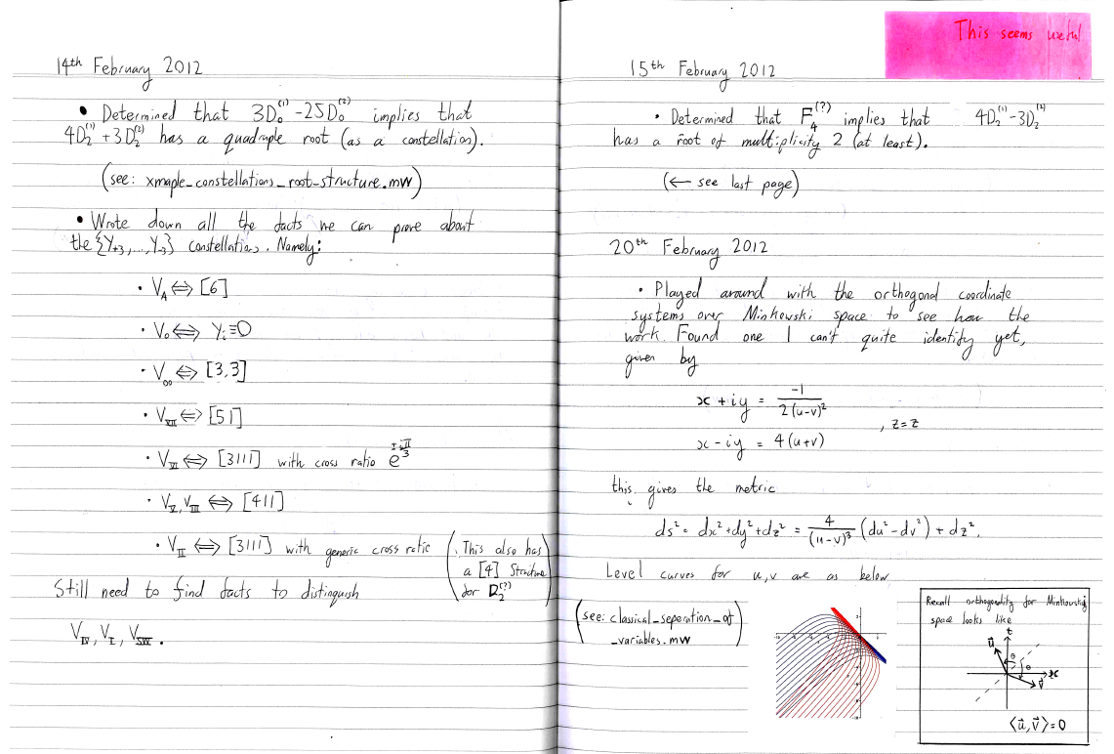

Slide 17
Three Rules for Collaborative Documentation

Slide 18

Cloud it / ensure access
DON'T HAVE ONE PERSON RESPONSIBLE FOR THE DOCUMENTATION
DON'T HAVE A FORM OF DOCUMENTATION THAT DOESN'T AUTO BACKUP
MAKE SURE EVERYONE CAN ACCESS THE DOCUMENTATION

Slide 19
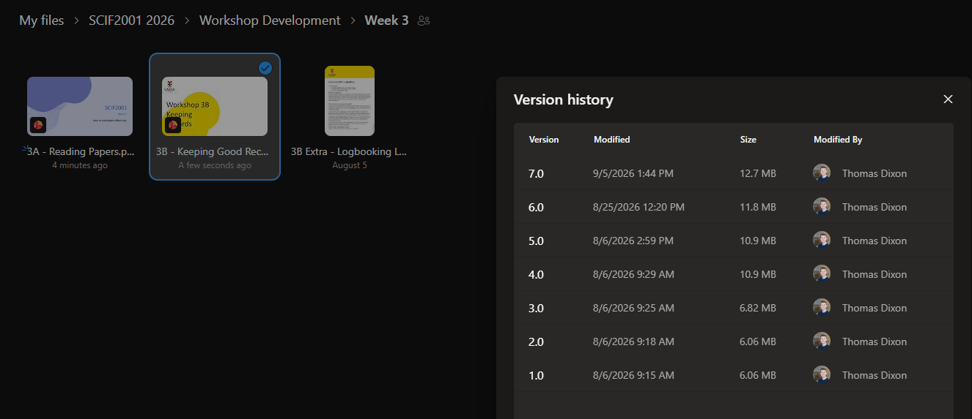
2) Version Control!!!
Make sure whatever system you use has VERSION CONTROL
This is so you can roll back!
Examples:
- One Drive
- Git Hub

Slide 20
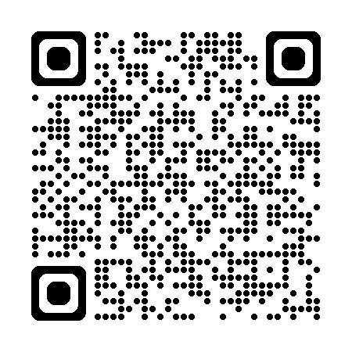
3) Folder Structure is SUPER Important
Check out this blog post:
"How I keep my projects organised"
Make it obvious where things are, and keep things separate.
E.g.
- Papers
- Raw Data
- Processed Data

